Slide 1
Coffee Café Night
Market And Retail Analytics
Submitted By: Ayush Jain
Mentor: Deepak Gupta

Slide 2
Index
Project Overview
Executive Summary
Exploratory Analysis
Menu Delisting
Mix Menu Analysis
Conclusions
Recommendations

Slide 3
Project Overview
The owner of the restaurant wants you to use this data to come up with a set of recommendations that can help his Café Chain increase his revenues. He has not been able to launch a loyalty program and is unable to provide you with a data set that has customer level information. But, he is able to provide you with a data set for POS (point of sale data) for one of his chains.

Slide 4
Executive Summary Coffee Café Night

Slide 5


Executive Summary And Key Findings
Provided Data is the Point of Sale data for one of the Retail Chain of one Financial year for the period of April 2010 – March 2011.
Total Revenue generated by the Café during this Period is: 32,805,895 with the total Quantity sold: 163,519.
Total Number of Bills Generated during this period is: 69,982

Slide 6
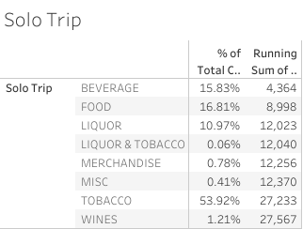
Executive Summary And Key Findings
Trip Segmentation: Out of total Number of bills there are 27,567 Bills with single transaction per bill, contributing to 39.39% of the total sales. Below is the Solo Trip distribution based on Category.
The Maximum contribution in the Solo trips are from Tobacco, contributing ~54% followed by Food and Beverages.

Slide 7
Exploratory Data Analysis Coffee Café Night

Slide 8
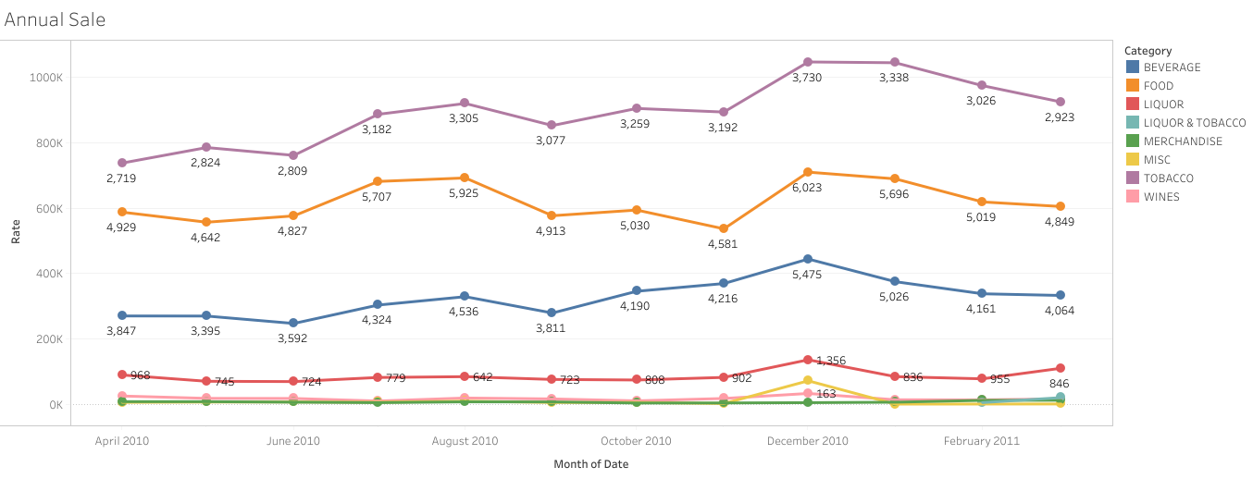
Sale Distribution based on Category
There is no sign of Trend or Seasonality in the Annual Sale Distribution.
Annual Sale Distribution based on the Category depicts that Tobacco appears to be the highest selling product generating the maximum sales in the Café.
We also notice, in all the Categories the Maximum Sale is recorded during the Month of December and January as 6,584,432 which is ~20% of the total Revenue generated.

Slide 9
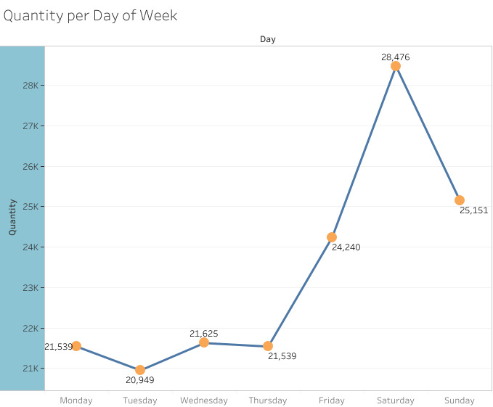
Weekly Distribution of Sales
In the Weekly distribution, we encountered a spike in Sales on Saturday. Total Number of Items sold during the period on Saturday are 28,476 with the total Revenue of 5,642,039
Tuesday appears to be a low sales day where the total number of Items sold are ~21k

Slide 10
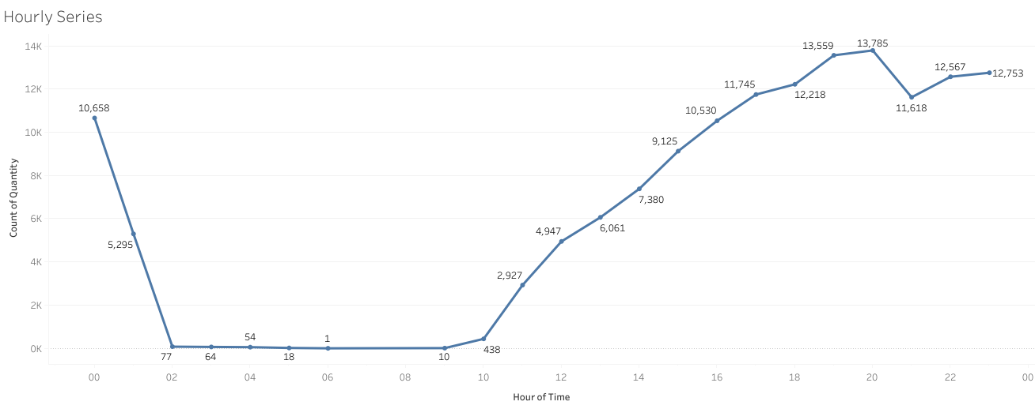
Sales Variations during the Day
Café records No transaction/ least transactions between the 0200- 0900 hours of the day i.e. a sum of 224 units sold.
During 1600-0200, Maximum sales is recorded with total units sold: 129,176 comprising in 26,298,396 as the total Revenue which is almost 80% of the total revenue generated.

Slide 11
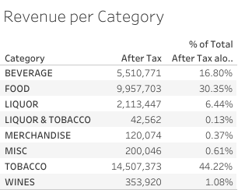
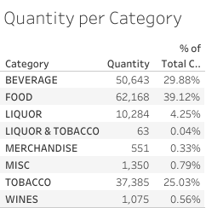
Categorical view on Revenue and Units Sold
In the Categorical view, Tobacco generates ~45% of the total Revenue followed by Food and Beverages contributing 30.35% and 16.80% respectively.
While Tobacco appears to be the major contributor in terms of revenue, Food is ranked highest in Items sold with 62,168 Items sold contributing ~40% of the total Items and Tobacco residing at the 3rd place.

Slide 12
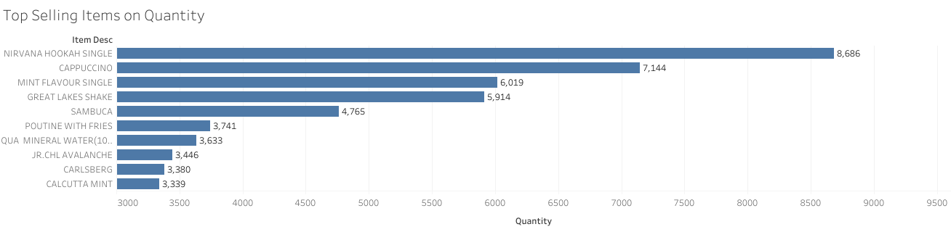
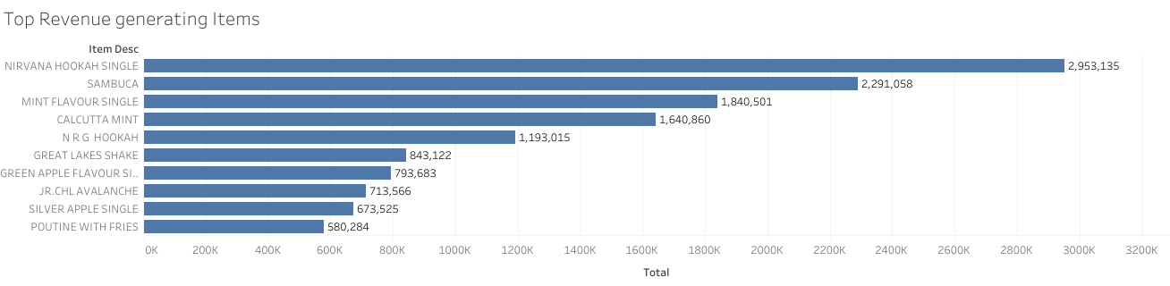
Top 10 Selling and Revenue generating Items
Graph shows the Top 10 selling Items where Nirvana Hookah Single is solely contributing to the highest sales with 8,686 units sold followed by Cappuccino and Mint Flavour Single.
Graph depicts that the Nirvana Hookah Single is generating the Revenue of 2,953,135 followed by Sambuca while Sambuca holds the 5th position in Top selling Items.

Slide 13
Price Variation Analysis Coffee Café Night

Slide 14
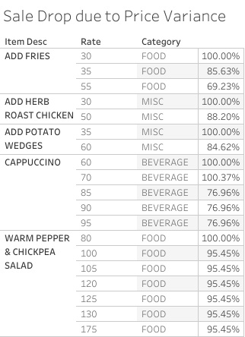
Price Change Effect on Sales
It is noticed that there are changes in price for few of the Menu Items. Below is the detailed analysis on Sale Drop due to the change in Price.
Add Fries have shown a drastic drop of ~30% in sales as the price increased from INR 30 to INR 55.
Sales of Cappuccino dropped by almost 25%.
Warm Pepper & Chickpea Salad showed of drop of 5% initially and then became constant with the price variation of INR 100 to INR 175.

Slide 15
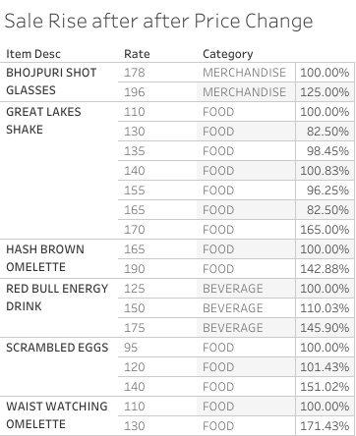
Price Change Effect on Sales
Below is the detailed analysis on Positive Effect on Sale due to the change in Price.
Waist Watching Omelette have shown a maximum rise in Sales of almost 70%.
Great Lakes Shake initially recorded a drop of ~20% and later rise by 65% in the sales after the price change
Items like Liquor and Tobacco mostly have showed positive or Neutral Response with the change in Price.

Slide 16
Item Delisting Coffee Café Night

Slide 17
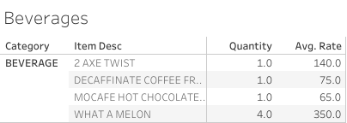
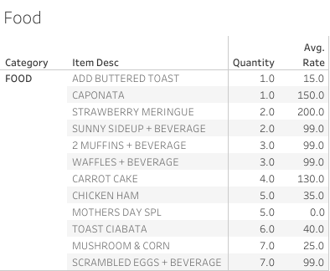

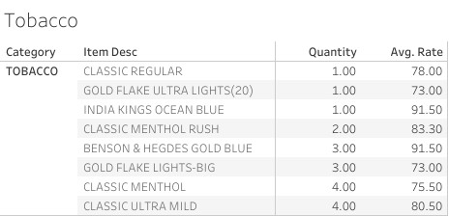
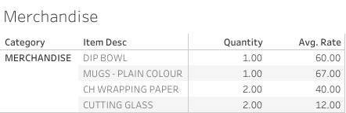
Item Delisting
Below are the Items that can be removed from the Menu as they have recorded the least sale during the period of 1 Financial Year.

Slide 18
Item Combination Analysis Coffee Café Night

Slide 19
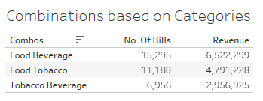
Combination of Categories
Combinations in the Menu can add flavours to the Sale of the Café. There are a few combinations that we came across in the data but are not adding much of the value.
As Observed, People who ordered Food have also bought Beverages. From the below table it can be seen that Number of bills with a combination of Food and Beverage is 15,295 which is ~25% of the total number of bills. Hence this combination can be the game changer in terms of the increasing the Sales of the Café.
Also, If Food served with Tobacco as a combination can prove to be a fair deal converting the Bills of Tobacco without Food to Tobacco with Food.

Slide 20
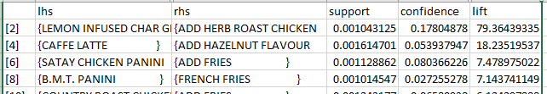
Combo of Items that can be added to the Menu.
Using the approach of Market Basket Analysis, we identified the Items that were brought in a combinations.
Below are a few combos that can be considered to be added in the Menu and can bring the significant hike in the Sales of the Café as they have gained the higher Lift ranging between 5-79 with a very high confidence level.
LEMON INFUSED CHAR GRILLED VEG & HERB ROAST CHICKEN
CAFFE LATTE AND HAZELNUTS FLAVOR
SATAY CHICKEN PANINI & ADD FRIES
B.M.T. PANINI & FRENCH FRIES
RED BULL & SAMBUCA
RED BULL ENERGY DRINK & N R G HOOKAH
GARDEN FRESH PANINI & COUNTRY LEMONADE
POTATO WEDGES & FRENCH FRIES
BEER HOOKAH & FRENCH FRIES

Slide 21
Conclusion & Recommendation Coffee Café Night

Slide 22
Conclusion
Single Trip contributes to 39.39% of the total Transactions in which ~54% of the total single Trip is added by Tobacco.
Maximum sale is recorded during the Month of December and January, which appears to be because of the Holiday Season.
Tobacco proves to be a leading Category with the contribution of 44.22% in the total Revenue.
Late Afternoon to Mid Night till 0200 sees maximum sales comprising of 80+% Sales of the whole Day.
Café requires to reconsider the Price change for the Items where the sale have dropped drastically because of the sudden Increase in price.
There are various Items hardly called and can be Delisted from the Menu.

Slide 23
Recommendations
Café can save Resources/ Salary by optimizing the operational Hours.
Cafe shows least or No sale from 0200- 0930, hence café can operate from 1000-0200
It can be operated in 2 shifts with Nine hours shift each.
Introduction to new Combos offers should be a game changer to convert larger Audience into Revenue.
Discounts should be offered during Happy Hours to attract more Customers that can help generate more Sales.
To promote café, Promotional Offers, Corporate/ Group discounts should be executed.
Café should start gathering Demographic Details of the Customer, which can be used later for Implementing Loyalty Program.

Slide 24
Thank You

